Slide 1
The Late Preterm Infant
Jessie Marks DNP, ARNP
Slides originally developed by
Yvonne Griffin, CNM, MSN

Slide 2
Objectives
Identify complications seen in late preterm newborns that impact newborn management.
Understand discharge criteria and recommended follow up of preterm infants
Identify common reasons for readmission for pre-term infants

Slide 3
Late Preterm Infant
The late preterm birth (34 to 36 weeks of gestation) rate rose from 6.82% in 2014 to 7.09% in 2016 (CDC, 2018).
Why the increase?
Possibly due to increase in c-section and induction of labor
6-8% unknown or elective, 29% spontaneous labor, 32% PPROM, 32% maternal indications (Laughon et al, 2010; Holland et al 2009)

Slide 4
Impact of immature systems
Thermoregulation and metabolic – small size/greater surface to mass ratio, less brown and white fat and increased metabolic consumption cause heat loss, hypothermia and hypoglycemia
Feeding – poor oro-motor tone and immature GI function lead to poor feeding, decreased stooling which increases risk for dehydration, hyperbilirubinemia, increased weight loss.
Hepatic – Immature hepatic metabolism, enterohepatic circulation and lower concentration of GI enzymes decrease stooling and increase hyperbilirubinemia
Respiratory – Immature lung structure, insufficient surfactant development and decreased residual capacity increase risk for poor gas exchange, fatigue and respiratory distress
CNS – Immature CNS chemoreceptor development and tone leading to apnea
Cardiovascular- increased risk for PDA and pulmonary hypertension
Notes:
Why we care about late preterm births: because of the physiologic and developmental immaturity
Late Preterm infants tire at breast more easily

Slide 5
Most frequent complications for late preterm infants
 | Morbidity % Late Preterm | Morbidity % Term
Feeding difficulties | 32.2 | 7.4
Hypoglycemia | 15.6 | 5.3
Temperature instability | 10 | 0
Jaundice | 54.4 | 37.9
Apnea | 4-12 | <0.1
Respiratory distress | 3.6-28.9 | 0.6-4.2
Sepsis workup | 36.7 | 12.6
Mechanically ventilated | 3.4 | 0.9
Source: Engle, et al 2007 (Meta-analysis). P<0.05

Slide 6
Lactation concerns – Maternal and Infant issues
Mom
Increased chance of having risk factors that negatively influence lactation success (C/S, high-risk pregnancy)
May have delayed lactogenesis
Infant
Decreased tone and immature neuro development can cause ineffective suckling and decreased suck-pressure
This ineffective suckling decreases the oxytocin and prolactin release as well as breast stimulus feedback system
Ineffective milk removal over a few days down-regulates production
Ineffective nursing can exacerbate other morbidities such as dehydration, jaundice
Source: Cleaveland, 2010; Meier, et al , 2007

Slide 7
Supplementation
Volumes and milk transfer may not be adequate initially. Both will improve over time as infant’s suck improves and as mom’s volumes increase
Late preterm infant may need supplementation to mom’s milk
Can be donor milk or formula
Regular pumping with hospital grade electric pump helpful in establishing (and maintaining) a supply until the infant can effectively feed and empty the breast.
Other resources like La Leche League, WIC, Lactation experts, …

Slide 8
Hyperbilirubinemia
Late preterm infants 2.4x risk for jaundice than term infants
1:4 preterm infants will need phototherapy
Increased risk of neurotoxicity and kernicterus
Causes:
Increased bilirubin load
Decreased liver enzyme activity
Decreased albumin binding
Increased enterohepatic shunting
Delayed secretion
Poor intake increases risk for jaundice because of delayed secretion
Source: Bhutani, 2006; Blackburn, 2007 ;Cleaveland, 2010, ; Lavanya, et, 2011

Slide 9
Management of the Late Preterm Infant
Promote thermoregulation and avoid cold stress
Monitor blood sugar and promote euglycemia
Monitor cardio-respiratory status; intervene if needed
Promote and support parent’s feeding preference including intervention if needed (involve lactation early)
Monitor for signs of sepsis; treat if indicated
Monitor for signs of hyperbilirubinemia and treat if indicated
Support neurodevelopment without overtiring
Facilitate safe discharge with appropriate follow up

Slide 10
Management Continued
Hypoglycemia monitoring
Screen infants for 24 hours
In neonates in whom hypoglycemia remains at or beyond age 48 hours (<60 mg/dl), the PES recommends a fasting challenge of 6 to 8 hours, with maintenance of blood glucose greater than 70 mg/dL, to distinguish from transitional hypoglycemia

Slide 11
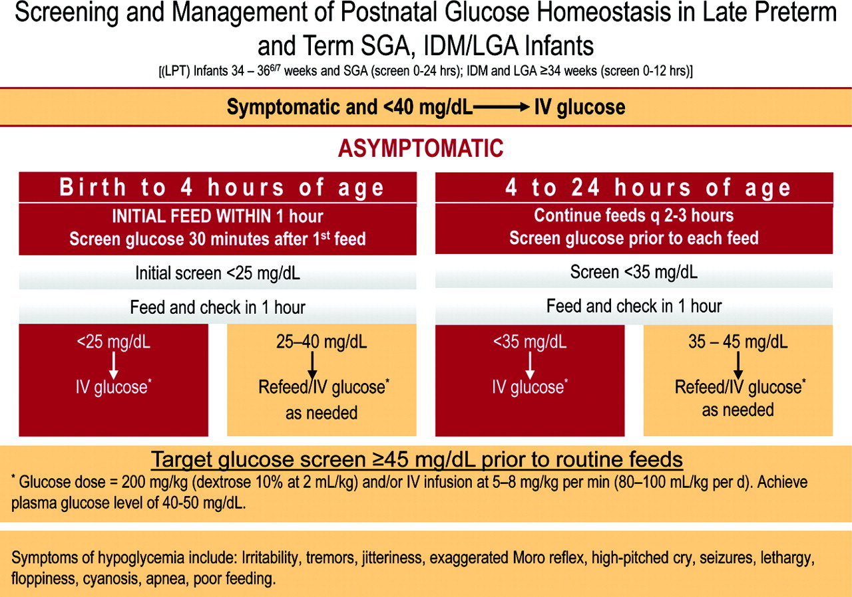
Notes:
AAP recommends that IDM and LGA are screen for at least the first 12 hours of life and SGA and preterm infants are screened for at least the first 24 hours.
Some authors also suggest infant with perinatal asphyxia which are APGARS < 5 min at 5 minutes, or multiple gestation.

Slide 12
Safe Discharge Criteria
Engle, et al, 2007
Accurate gestational age assessment
Stable vital signs x 24 hours with Temp 36.5-37.4C
Stooled at least once
Successful feeding x 24 hours with <2-3% weight loss in 24 hours, 7% for hospital stay
Formal breastfeeding evaluation
Identified Pediatric provider with follow up care arranged for 24-48 hours after discharge

Slide 13
Discharge Criteria continued
Feeding plan established
Usual labs and screening including bilirubin, newborn screening, hearing, Critical Congenital Heart Disease (CCHD)
Car seat oximetry
Family education/evaluation of understanding of warning signs and follow up plan
Individualized plan based on all the above criteria and any illness or social risk factors – may be longer than usual stay until infant stable
Delay discharge until infant is at least 48 hours old

Slide 14
Outpatient Follow up
Evaluated within 24-48 hours from discharge
Weekly follow up is recommended until infant is 40 weeks corrected or until clearly thriving
More frequent visits may be needed if bilirubin or weight checks are indicated

Slide 15
Hospital Readmission
Readmission rate of late preterm infants is up to 3x that of full-term infants
Reasons for readmission
Jaundice
Respiratory distress
Feeding issues

Slide 16
References
Ashton, D.M. (2010). Elective delivery at less than 39 weeks. Current Opinion in Obstetrics and Gynecology. 22: 506-10
Blackburn, S.T. (2007). Maternal, fetal and neonatal physiology: A clinical perspective, hyperbilirubinemia section.
Boyle, J.D. & Boyle, E.M. (2011). Born just a few weeks too early: Does it matter? Archives of Disease in Child. Fetal and Neonatal Edition, doi:10.1136/archdischild-2011-300535.
Bhutani, V.K., Schwoebel, A., & Gennaro, S. (2006). A systems approach for neonatal hyperbilirubinemia in term and late preterm infants. Journal of Obstetric, Gynecologic, and Neonatal Nursing, 35:444-455.
Engle, W.A., Tomashek, K.M., & Wallman, C. (2007). Late preterm infants: A population at risk. Pediatrics, 120:1390-1401.
Gayamfi-Batterman, C., Thom, E.A., Blackwell, S.C, et al. (2016). Antenatal Betamethasone for Women at Risk for Late Preterm Delivery. The New England Journal of Medicine. 374(14): 1311-1320.
Holland, M.G., Refuerzo, J.S., Ramin, S.M., et al. (2009). Late preterm birth: How often is it avoidable? American Journal of Obstetrics and Gynecology, 201, 404.e1-4.
Laughon, S.K., Reddy, U.M., Sun, L., et al. (2010). Precursors for late preterm birth in singleton gestations. Obstetrics and Gynecology, 116: 1047-1055.

Slide 17
References, continued
Lavanya, K.R., Jaiswal, A., Reddy, P. & MURKI, S. (2012). Predictors of significant jaundice in late preterm infants. Indian Pediatrics, 49: 717-20.
Mathews, T.J., MacDorman, M.F., & Thoma , M.E. (2015). Infant Mortality Statistics From the 2013 Period Linked Birth/Infant Death Data Set. National Vital Statistics Reports. Retrieved from http://www.cdc.gov/nchs/data/nvsr/nvsr64/nvsr64_09.pdf
McLaurin, K.K., Hall, C.B., Jackson, E.A., et al. (2009). Persistence of morbidity and cost differences between late-preterm and term infants during the first year of life. Pediatrics, 123: 653-659
Meier, P.P., Furman, L.M., & Degenhardt, M. (2007). Increased lactation risk for late preterm infants and mothers: Evidence and management strategies to protect breastfeeding. Journal of Midwifery & Women’s Health. 52: 579-587.
Munson, M., Saatkamp, R., & West, C. (2011). Late preterm infants: Steps to success. Neonatal Network, 30(4), 267-270.
Martin, J.A., Kirmeyer, S., Osterman, M. & Shepherd, R.A. (2009). Born a bit too early: Recent trends in late preterm births. NCHS Data Brief, 24: 1-9.
Walker, M. (2008). Breastfeeding the late preterm infant. Journal of Obstetric, Gynecologic, and Neonatal Nursing. 37: 692-701.
QuickStats: Changes in Late Preterm Birth Rates, by State — National Vital Statistics System, United States, 2014 and 2016. MMWR Morb Mortal Wkly Rep 2018;67:696. DOI: http://dx.doi.org/10.15585/mmwr.mm6724a7.

